Slide 1
STUDENT LEARNING MODELS Review - 2
Department of Information Technology
Deep Learning Framework for Speech to Text Conversion in Dysarthric patients
Under the Guidance
of
Ms. C. S. L. Vijaya Durga
Batch Number: 08
24951A1256 - T. NAVANEETH REDDY
25955A1203 - D. MADHU

Slide 2
Project Overview
Dysarthria is a motor speech disorder that affects a person’s ability to articulate speech clearly due to neurological damage affecting speech muscles.
Conventional Automatic Speech Recognition (ASR) systems are trained on normal speech and perform poorly when applied to dysarthric speech.
This project proposes a deep learning–based speech-to-text framework specifically designed for recognizing dysarthric speech patterns.
Notes:
Dysarthria is a motor speech disorder that affects the clarity of speech due to neurological impairments that impact muscle control. Because of this, individuals with dysarthria often produce speech that differs significantly from normal speech patterns. Most existing speech-to-text systems are trained using normal speech datasets, which makes them unreliable for recognizing dysarthric speech.
In this project, we propose a deep learning–based framework designed specifically for dysarthric speech recognition. The system processes speech signals through preprocessing, feature extraction, and deep learning–based modeling to generate accurate text transcriptions. The goal of this framework is to improve accessibility and enable better communication support for individuals with dysarthria.

Slide 3
Project Overview
The system processes speech signals using audio preprocessing, feature extraction, and deep learning models to improve transcription accuracy.
The framework aims to support assistive communication technologies that help dysarthric patients interact with digital systems more effectively.
Notes:
Dysarthria is a motor speech disorder that affects the clarity of speech due to neurological impairments that impact muscle control. Because of this, individuals with dysarthria often produce speech that differs significantly from normal speech patterns. Most existing speech-to-text systems are trained using normal speech datasets, which makes them unreliable for recognizing dysarthric speech.
In this project, we propose a deep learning–based framework designed specifically for dysarthric speech recognition. The system processes speech signals through preprocessing, feature extraction, and deep learning–based modeling to generate accurate text transcriptions. The goal of this framework is to improve accessibility and enable better communication support for individuals with dysarthria.

Slide 4
Problem Statement
To develop a deep learning-based speech-to-text system specifically designed for dysarthric speech, capable of improving recognition accuracy and supporting assistive communication technologies.
Dysarthric speech often contains irregular articulation, slurred pronunciation, and inconsistent speech patterns, which significantly degrade recognition performance.
As a result, conventional speech-to-text systems produce high word error rates when processing dysarthric speech.

Slide 5
Objectives
To design a deep learning–based framework for speech-to-text conversion tailored for dysarthric speech.
To collect and utilize a dysarthric speech dataset for training and evaluating the recognition system.
To perform audio preprocessing and acoustic feature extraction to capture relevant speech characteristics.
To train and evaluate a deep learning speech recognition model capable of handling variations in dysarthric speech.
To develop a prototype system that converts dysarthric speech into readable text to support assistive communication.

Slide 6
Dataset Selection
Dataset: Noise-Reduced UASpeech Dysarthria Dataset (Kaggle)
Source: Based on the UASpeech Dysarthric Speech Corpus
Characteristics of the data set :
Parameter | Description
Dataset Type | Dysarthric speech corpus
Audio Format | WAV
Sampling Rate | 16 kHz
Speech Content | Isolated words
Vocabulary Size | ~765 words
Data Quality | Noise-reduced recordings
Speakers | Dysarthric and control speakers

Slide 7
Reason for Selecting this Dataset
Specifically designed for dysarthric speech recognition research
Provides clean, noise-reduced audio recordings suitable for training deep learning models
Contains multiple speakers and repeated utterances for improved model learning
Widely used in assistive speech recognition studies

Slide 8
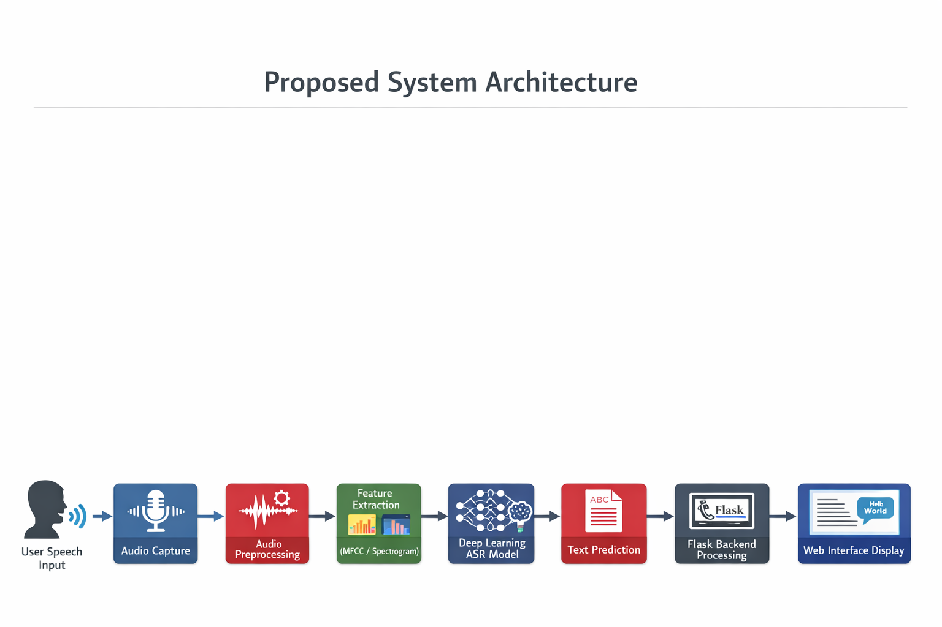
System Architecture

Slide 9
System Architecture
The system accepts speech input from the user.
Audio signals are processed through preprocessing techniques to improve quality.
Feature extraction converts speech signals into acoustic features suitable for model training.
A deep learning speech recognition model analyzes these features and predicts the corresponding text.
The output is processed through a Flask-based backend and displayed on a web interface.

Slide 10
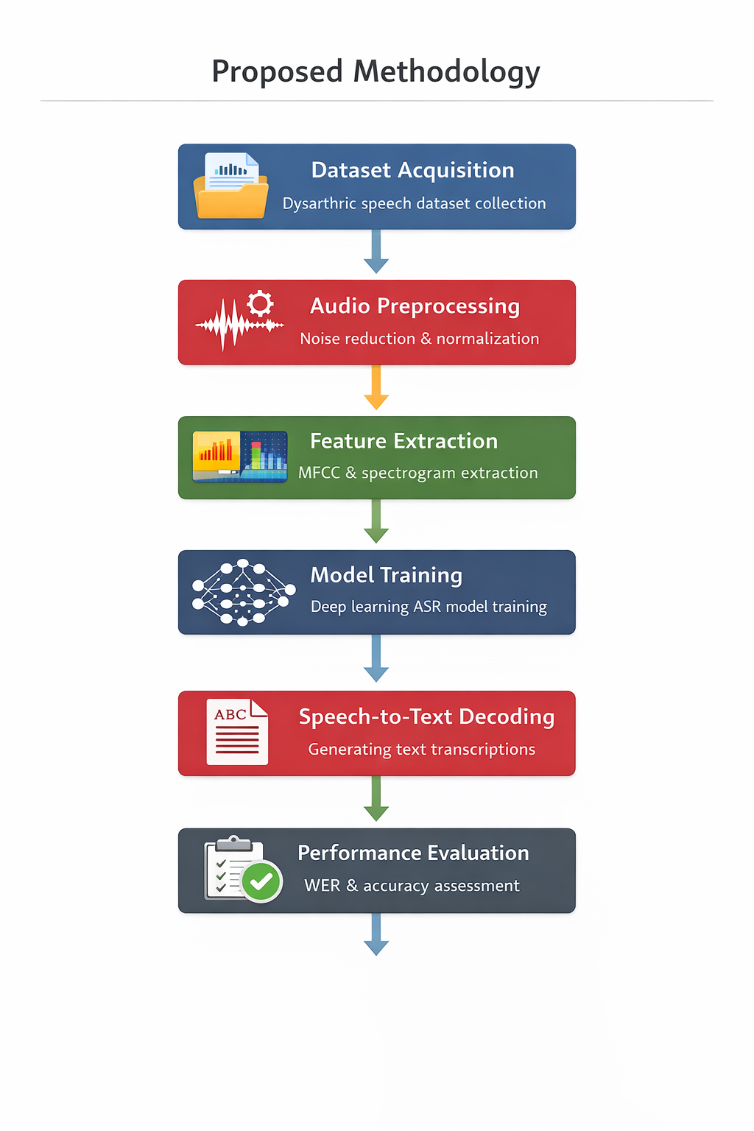
Proposed Methodology
Dataset Acquisition : Dysarthric speech recordings are obtained from the selected dataset.
Audio Preprocessing : Audio normalization and noise handling are performed to improve signal quality.
Feature Extraction : Acoustic features such as MFCC representations are extracted from audio signals.
Model Training : Extracted features are used to train a deep learning–based speech recognition model.
Speech-to-Text Decoding : The trained model predicts the corresponding text output from speech input.
Performance Evaluation : The system performance is evaluated using metrics such as Word Error Rate (WER) and recognition accuracy.

Slide 11
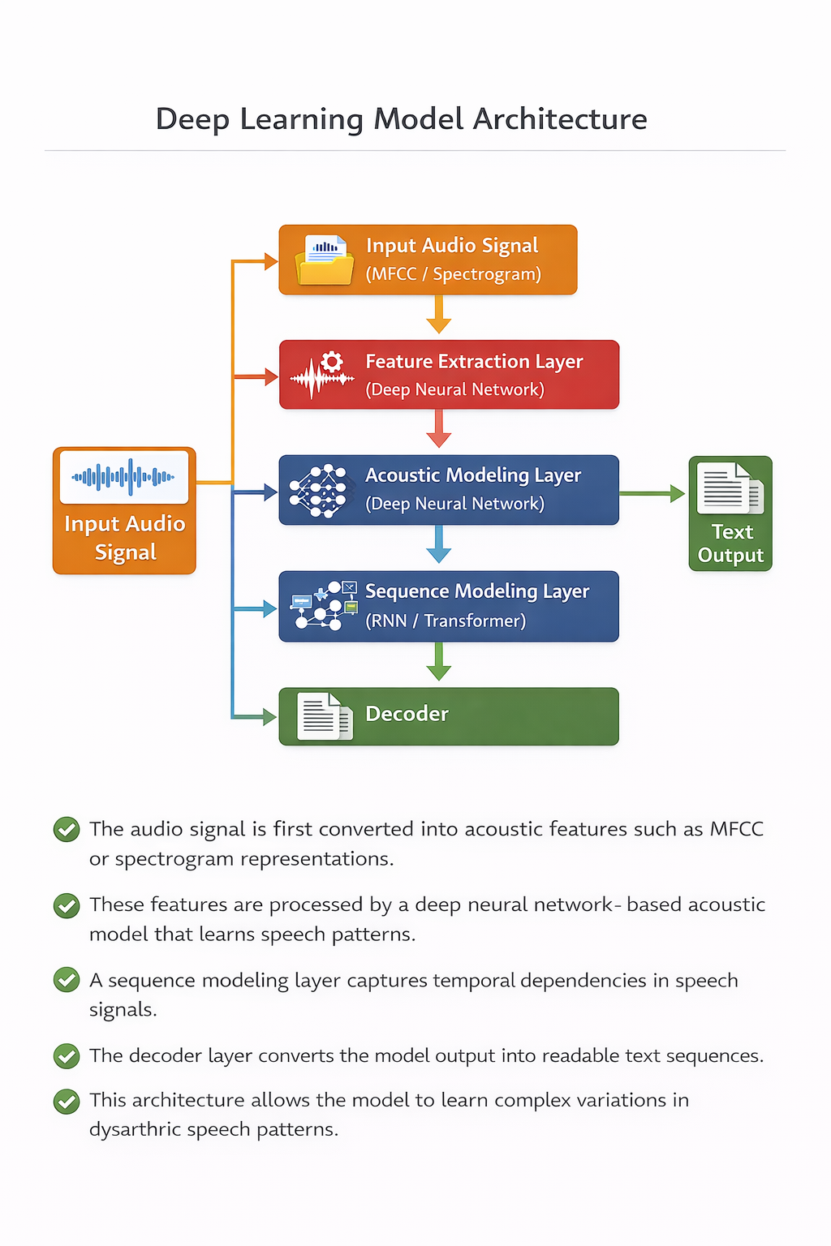
Deep Learning Model Architecture
The audio signal is first converted into acoustic features such as MFCC or spectrogram representations.
These features are processed by a deep neural network–based acoustic model that learns speech patterns.
A sequence modeling layer captures temporal dependencies in speech signals.
The decoder layer converts the model output into readable text sequences.
This architecture allows the model to learn complex variations in dysarthric speech patterns.

Slide 12
Technology Stack
Layer | Technology
Frontend | HTML, CSS, JavaScript
Backend | Python (Flask / FastAPI)
Speech Processing | Librosa, SpeechBrain
Model | Pretrained Deep Learning ASR
Framework | PyTorch / TensorFlow
Development Environment | Jupyter Notebook / Google Colab
Hosting | Local System / Cloud Environment

Slide 13
Work Plan
Phase | Task
Phase 1 | Problem analysis, literature review, methodology design
Phase 2 | Dataset selection and system architecture design
Phase 3 | Model implementation and training
Phase 4 | System integration with backend and web interface
Phase 5 | Testing, evaluation, and result analysis

Slide 14
Innovation
Dysarthric Speech Focus : The system is specifically designed to recognize dysarthric speech patterns, unlike conventional ASR systems trained only on normal speech.
Use of Deep Learning for Pathological Speech Recognition : Deep learning models are employed to learn complex variations and irregular articulation patterns present in dysarthric speech.
Noise-Reduced Dysarthric Dataset Utilization : The system uses a noise-reduced dysarthric speech dataset, improving model training quality and recognition performance.

Slide 15
Expected Results
Improved Speech Recognition Accuracy : The deep learning model is expected to achieve better transcription accuracy for dysarthric speech compared to conventional ASR systems.
Reduction in Word Error Rate (WER) : The proposed framework aims to significantly reduce word error rates when recognizing dysarthric speech.
Reliable Speech-to-Text Conversion : The system will convert dysarthric speech signals into readable and meaningful text outputs.

Slide 16
Conclusion
The project proposes a deep learning–based speech-to-text framework designed specifically for dysarthric speech recognition.
By utilizing dysarthric speech datasets, preprocessing techniques, and deep learning models, the system aims to improve transcription accuracy.
The proposed framework can support assistive communication technologies for individuals with speech impairments.
The system also provides a scalable foundation for future research in pathological speech recognition and accessibility technologies.

Slide 17
THANK YOU

